Slide 1
Does Parameter Tuning Enhance the performance of the state-of-the-art Classifiers?
An empirical study of technical interview candidates’ cognitive load
Mahnaz Behroozi

Slide 2
Outline
Motivations
Problem overview and research questions
Dataset
Methodology and Experimental design
Results
Answers to research questions
Future work
References
How to answer our research questions?

Slide 3
Motivations
Finding out if technical interview settings affect the stress level and cognitive load of the candidates
Ultimate Goals:
Suggesting a better interview setting to:
Help candidates to show their skills by helping them feel less stressed
Help the recruiters to hire the most skillful candidates

Slide 4
Problem overview and research questions
Goal:
To predict if candidates are stressed or not via tracking their eye-movement
Important research questions:
RQ2: Which eye-tracking measurements are predictive of cognitive load?
RQ3: How much do the properties of the interview setting affect the eye-movement measurements?
RQ4: Does parameter tuning enhance classification results?
RQ1: Is cognitive load in technical interviews detectable through eye-tracking?

Slide 5
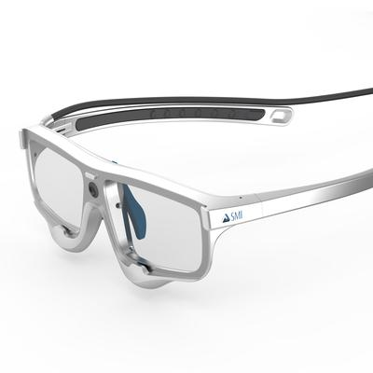
Dataset
Who were the participants?
8 graduate and 3 undergraduate students
What was collected?
The recordings of participants’ eye-movement while they were solving one coding question on the paper and another one on the whiteboard.
What was extracted?
The eye-tracking measurements such as saccade, visual intake (fixation), blinks, and etc.

Slide 6
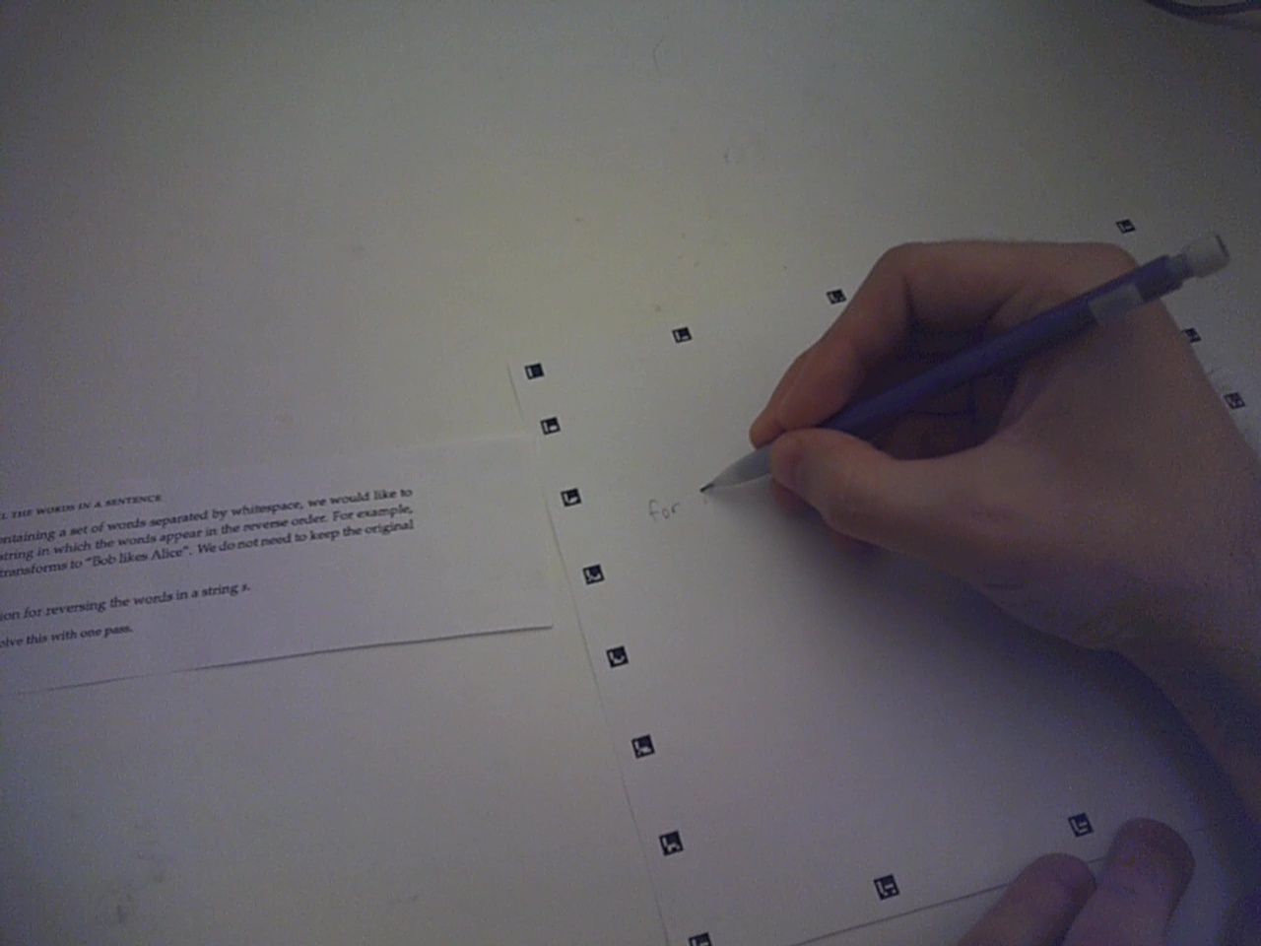
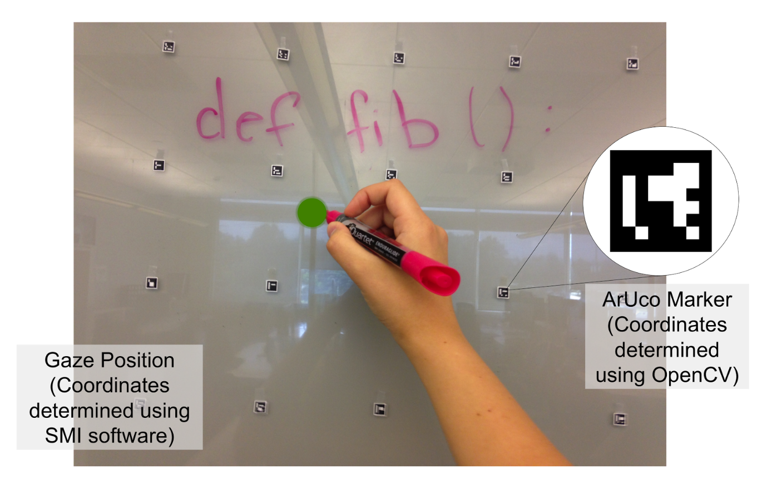
Methodology and Experimental Design
Steps we took to setup the experiment:
Placing boundaries for the coding areas with ArUco markers
Forming a grid of ArUco markers on the whiteboard to determine AOIs for the coding area
3-point calibration of the eye-tracker for each participants

Slide 7
Methodology and Experimental Design (cont.)
Why ArUco markers?
To tackle occlusion
To locate the gaze point in each frame of the recording
To determine the boarder of the coding area
To calculate the number of gaze regressions

Slide 8
Methodology and Experimental Design (cont.)
Why to place ArUco markers in the form of a grid on the whiteboard?
To have at least one marker in each frame since candidates change their distance from the whiteboard
What do participants were asked to do?
To solve two questions of similar difficulty, one on the paper and another one on the whiteboard

Slide 9
Methodology and Experimental Design (cont.)
Test used for finding statistically significant different eye-tracking measurement in two interview settings:
Wilcoxon signed-rank test
Reporting those measurements with meaningful p-values (less than 0.05)

Slide 10
Methodology and Experimental Design (cont.)
Classification algorithms used:
Naïve Bayes
Random Forest
Multi-layer Perceptron
SVM
KNN
Logistic Regression
Decision Tree

Slide 11
Methodology and Experimental Design (cont.)
Model validation technique used:
10-fold cross validation
Performance measures:
Accuracy
Precision
Recall
F-measure
Roc Area

Slide 12
Methodology and Experimental Design (cont.)
Parameter tuning techniques based on:
R. Kohavi (1995). Wrappers for Performance Enhancement and Oblivious Decision Graphs. Department of Computer Science, Stanford University.
Chris Thornton, Frank Hutter, Holger Hoos,, Kevin Leyton-Brown: Auto-WEKA: Combined Selection and Hyperparameter Optimization of Classification Algorithms. In: Proc. of KDD 2013, 2013.

Slide 13
How to answer our research questions?
RQ1: Is cognitive load in technical interviews detectable through eye-tracking?
Hypothesized that the whiteboard interview is more stressful
Surveyed our participants after taking the two tests to confirm our hypothesis
Labelling the data based on the settings
Applying classification algorithms on labeled data

Slide 14
How to answer our research questions? (cont.)
RQ2: Which eye-tracking measurements are predictive of cognitive load?
After answering RQ1, we can highlight those eye-tracking measurements correlated to the labelling of the data
To answer RQ3, we can focus more on the measurements which the literature shows to be effective. More specifically, saccade and visual intake

Slide 15
How to answer our research questions? (cont.)
RQ3: How much do the properties of the interview setting affect the eye-movement measurements?
Applying the classifiers on different labelling of the data (based on the setting and based on participant survey as stressed/not stressed)
Comparing the performance of the classifiers
For labelling based on user survey, partition the data into 4 chunks: VI/saccade on the whiteboard, VI/saccade on the paper
For labelling based on the setting, partition the data into 2 chunks: VI and saccade (regardless of the setting)

Slide 16
How to answer our research questions? (cont.)
RQ4: Does parameter tuning enhance classification results?
Apply parameter tuning on the classifiers we used for two labelling
Compare how effective the parameter tuning is in both cases

Slide 17
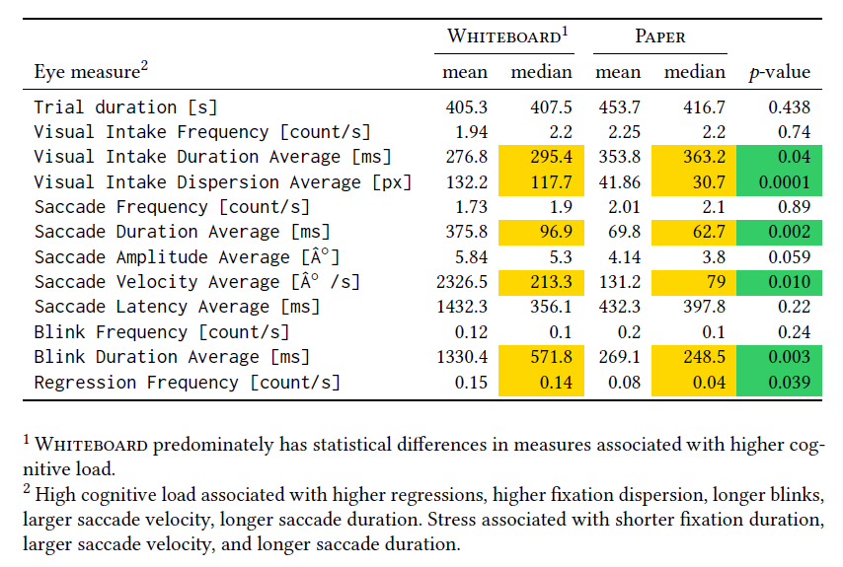
Results
Statistical significant differences of various summary eye-movement measures between different interview settings

Slide 18
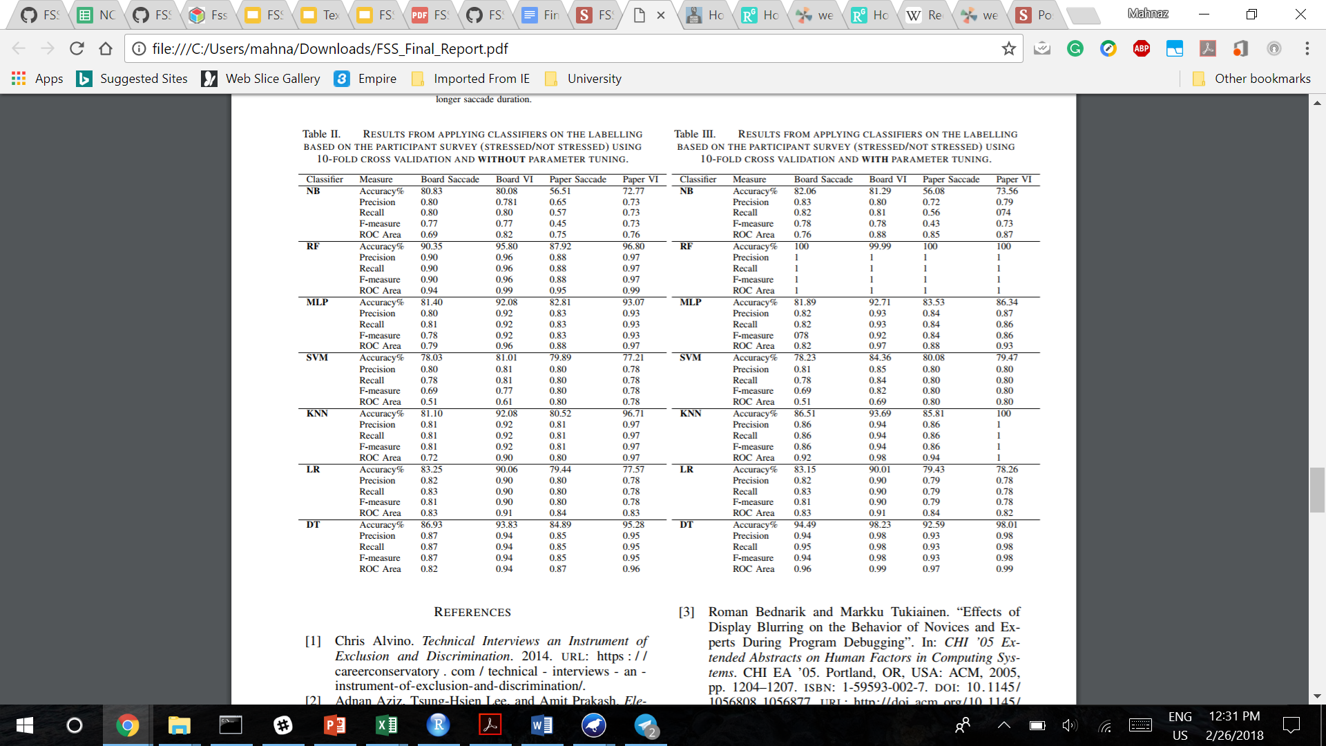
Results (cont.)
RESULTS FROM APPLYING CLASSIFIERS ON THE LABELLING BASED ON THE PARTICIPANT SURVEY (STRESSED/NOT STRESSED) USING 10-FOLD CROSS VALIDATION AND WITHOUT PARAMETER TUNING.

Slide 19
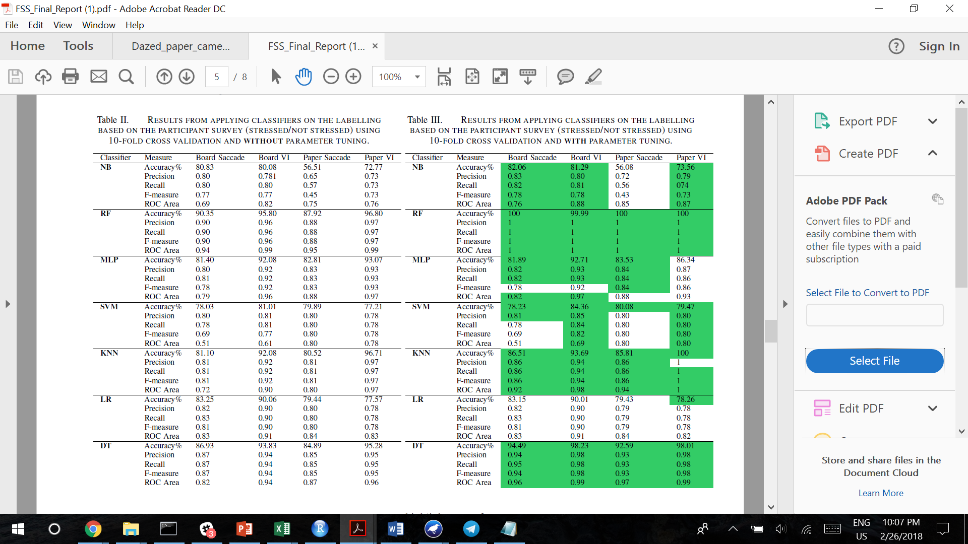
Results (cont.)
RESULTS FROM APPLYING CLASSIFIERS ON THE LABELLING BASED ON THE PARTICIPANT SURVEY (STRESSED/NOT STRESSED) USING 10-FOLD CROSS VALIDATION AND WITH PARAMETER TUNING. Enhanced results highlighted in green.

Slide 20
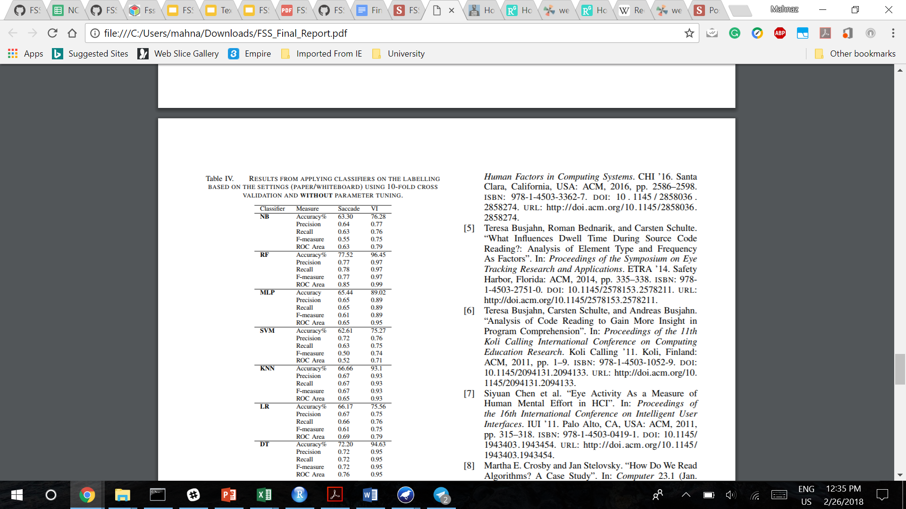
Results (cont.)
RESULTS FROM APPLYING CLASSIFIERS ON THE LABELLING BASED ON THE SETTINGS (PAPER/WHITEBOARD) USING 10-FOLD CROSS VALIDATION AND WITHOUT PARAMETER TUNING.

Slide 21
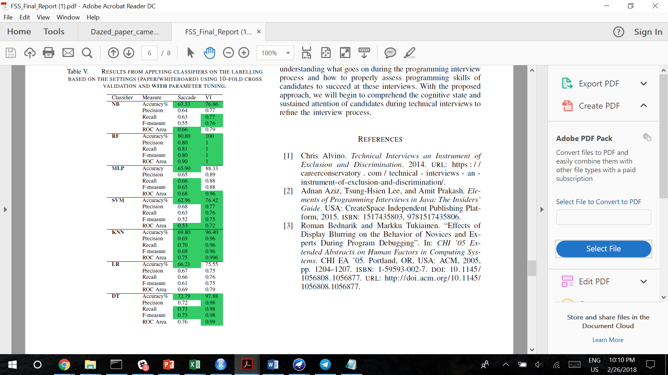
Results (cont.)
RESULTS FROM APPLYING CLASSIFIERS ON THE LABELLING BASED ON THE SETTINGS (PAPER/WHITEBOARD) USING 10-FOLD CROSS VALIDATION AND WITH PARAMETER TUNING.

Slide 22
Future work
Simple vs. Complex tasks on a whiteboard
Solving problems on whiteboard, but in a private room
Effect of interviewer interruption
Effect of previous problem practice
Applying other parameter tuning techniques

Slide 23
Thank you!

